Slide 1
Software Engineering Project
GDProject
Yashiya Minor
Dane Medlin
Austin Silfies-heater
Cameron Pacileo

Slide 2
Overview of our Product
Our product is designed to provide a visual representation of sociological data and its correlation with specific relative variables
If an individual is seeking to find data on a specific country in the world, our website would be capable of creating and exporting a graph to the user which will provide the user with a visual representation of the data with a varying type of graph.
Along with graph creation, our website also provides the user with options to add variables onto the graph, and add more countries. This adds to the amount of data that the graph can hold.

Slide 3
Who is our audience?
Anyone who wants an intuitive data comparison chart.
Data Analysts interested in comparisons between countries at specific time frames
People who like nice graphs and have internet access

Slide 4
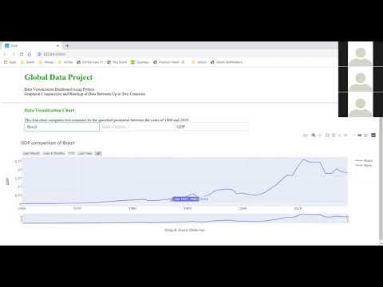
Demo

Slide 5
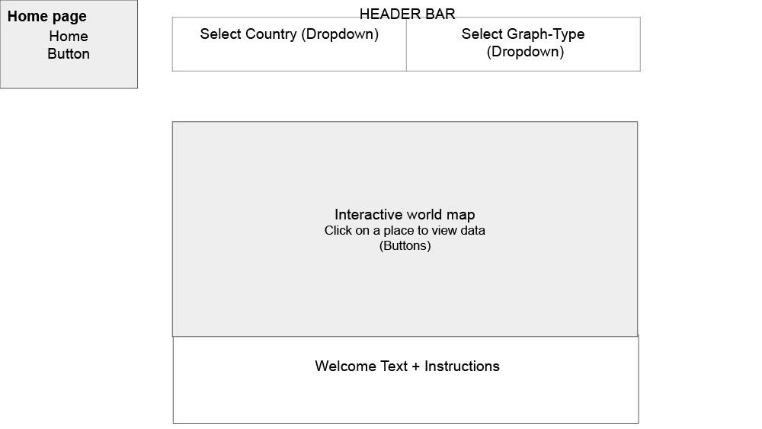
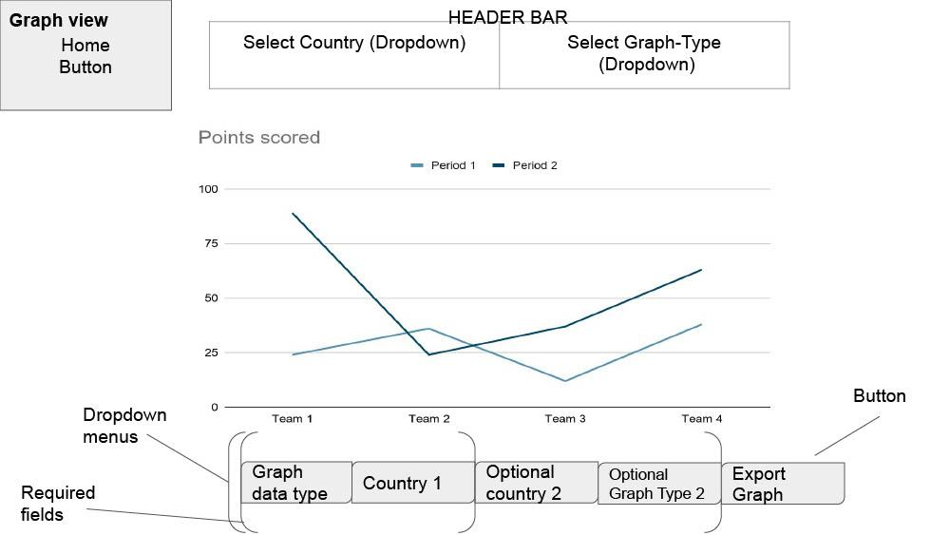
The System Model

Slide 6
Customer/Partner Team Feedback
Parts of the product were not intuitive enough
Exact purpose of the product was unclear
Product was not yet fully functional

Slide 7
Possible Additional Enhancements
Additional parameters to examine and test with
Export button to save graphs for personal use
Further improvements on intuitiveness

Slide 8
Major Challenges / Lessons Learned
Unclear assignments -> cover our backs
Lack of precise instructions -> work with peers
Little prior experience -> adaptability
Online environment -> Discord & pings
Multiple assignments at once -> task delegation

